Slide 1
Meeting Week 1
This lets you steer the meeting to what you require out of the meeting to make progress.
Last week summary
Action point 1
…
Question 1
…
Outline ToDo next week

Slide 2
Last week summary
Theory or research discussed last week summarized. What was discussed last week. Professor and PhD only work on this project 1-2hrs per week not 40hrs like you.
Some figure explaining the concept
When applicable, the same as will go in final report. Otherwise just take screenshots from relevant papers.

Slide 3
Action point 1
You should have a Gantt-chart or some other planning with what should be the next steps in the research.
Questions can also be put here
Some figure showing the result achieved like a plot or some theory.
When applicable, the same as will go in final report. Otherwise just take screenshots from relevant papers.

Slide 4
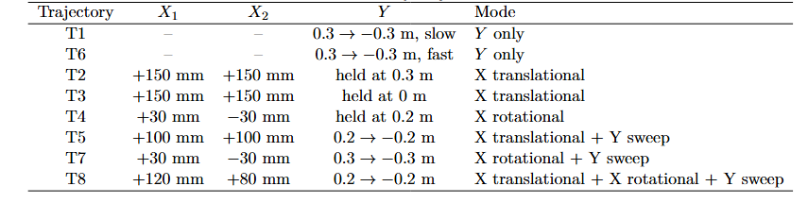
Trajectories
T1-T6 isolate simple motion types
Added T7 and T8 to improve coupling terms identifiability

Slide 5
Why multisine?
Goal: improve parameter identifiability
What
- Add broadband excitation to the nominal trajectories.
- Inject as plant-input force after the controller:
u_total = u_fb + f_ms
Why
- Smooth trajectories mainly excite low-frequency motion.
- Some parameters are weakly visible from the nominal motion alone.
- Force injection keeps the reference trajectory clean.
How
- Use the same nominal trajectory r_traj.
- Add f_ms to the plant input.
- Save u_total and q1 for identification.

Slide 6
How The Multisine Is Built
Periodic Schroeder-phase multisine
What
- s(t) = sum_i cos(2*pi*f_i*t + phi_i)
- phi_i = -i(i-1)pi/F
Why
- Multisine excites many frequencies in one simulation.
- Schroeder phases reduce crest factor: peak/RMS.
- Lower peaks make the excitation safer for the same RMS force.
How
- 1 s period -> 1 Hz frequency grid.
- Select odd frequency lines inside the candidate band.
- Normalize to unit RMS, then scale to candidate force RMS.

Slide 7
How It Is Applied And Selected
Modal mapping and diagnostic selection
What
- common: [s, s, 0] -> X translation
- diff: [s, -s, 0] -> rotation/yaw
- y: [0, 0, s] -> Y motion
Why
- Each mode excites a physically meaningful direction.
- The feedback controller can reject injected force.
- Therefore amplitude/frequency must be selected in closed loop.
How
- First simulate baseline with f_ms = 0.
- Test candidate frequency band and RMS force combinations.
- Rank by:
survival x extra motion x bandwidth
- Accept only if force and motion limits are respected.

Slide 9
Multisine Signal Construction
Periodic Schroeder-Phase Multisine, Injected as force after controller
s(t) = sum_i cos(2*pi*f_i*t + phi_i)
Frequency design
- 1 s period -> Δf = 1 Hz
- selected bins inside candidate band
- odd harmonic lines only
- trajectory padded to complete periods
Phase design
- Schroeder phases:
phi_i = -i(i-1)pi/F
- reduces crest factor = peak / RMS

Slide 10
Amplitude And Modal Mapping
Amplitude and Force Modes
Amplitude
- normalize to unit RMS
- scale to candidate force RMS
- 0.1 s cosine ramp avoids startup force jump
Modal mapping
- common: [s, s, 0] -> X translation
- diff: [s, -s, 0] -> rotation/yaw
- y: [0, 0, s] -> Y motion
MIMO detail
- mode-dependent phase shift
- reduces correlation when modes are combined

Slide 11
Closed-Loop Diagnostic Selection
Closed-Loop Diagnostic Selection
Why diagnostic?
- Feedback controller can reject injected force.
- Large force does not guarantee useful plant excitation.
Procedure
1. Simulate clean trajectory: f_ms = 0
2. Test candidate band / RMS force combinations
3. Compare with baseline:
extra motion Δq
surviving force Δu
4. Rank:
score = survival x extra motion x bandwidth
5. Accept only within:
force peak/RMS limits
position/yaw limits
velocity limits

Slide 13
Multisine design
Injected as force after controller
Schroeder-phase periodic multisine
  Resolution and padding
  Frequency bins
  Crest factor → Schroeder phase rule
Odd Harmonic Selection
Normalize multisine
Scale to candidate force level
Notes:
s(t) = sum_i cos(2*pi*f_i*t + phi_i)
phi_i = -i(i-1)pi/F

Slide 14
Multisine Signal Construction
Goal:
- Broadband excitation for parameter recovery in one simulation.
Periodic Schroeder-phase multisine:
s(t) = sum_i cos(2*pi*f_i*t + phi_i)
Schroeder phases:
phi_i = -i(i-1)pi/F
Design choices:
- 1 s period → 1 Hz frequency resolution
- integer-period padding → leakage-free signal
- selected frequency bins within candidate band
- odd harmonics only → even lines left unexcited
- Schroeder phases → lower crest factor

Slide 15
Mode-Dependent Phase Offset
Modes
And: That is why the script adds the mode-dependent phase/time shift. So the concept is:
is equivalent to a time shift by \(\tau\). In your script:
common: [s_common, s_common, 0]
diff: [s_diff, -s_diff, 0]
y: [0, 0, s_y]

Slide 16
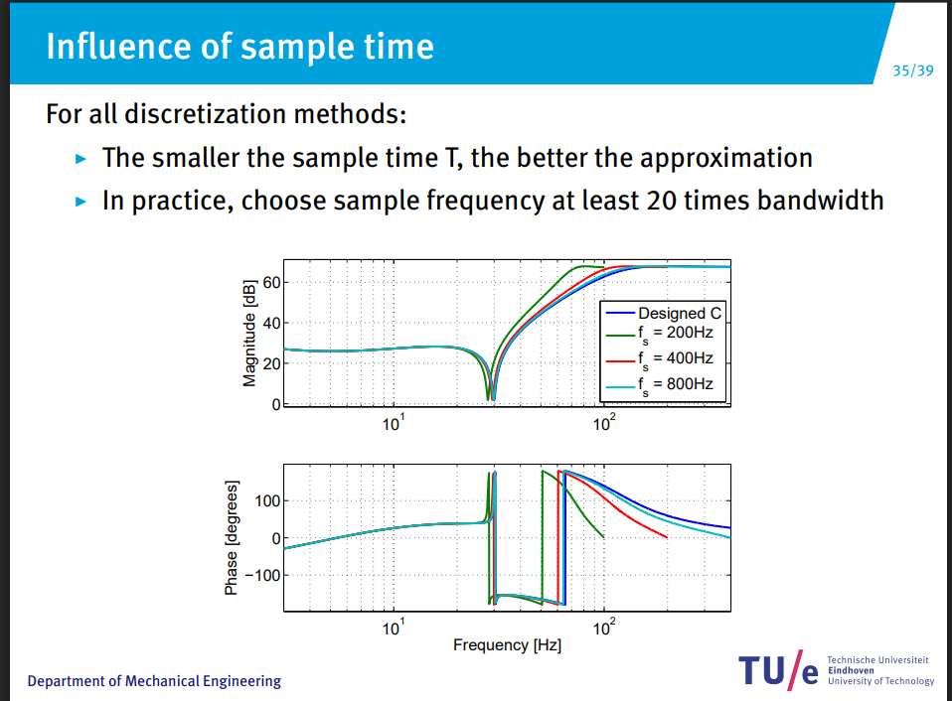
Trajectory analysis

Slide 17
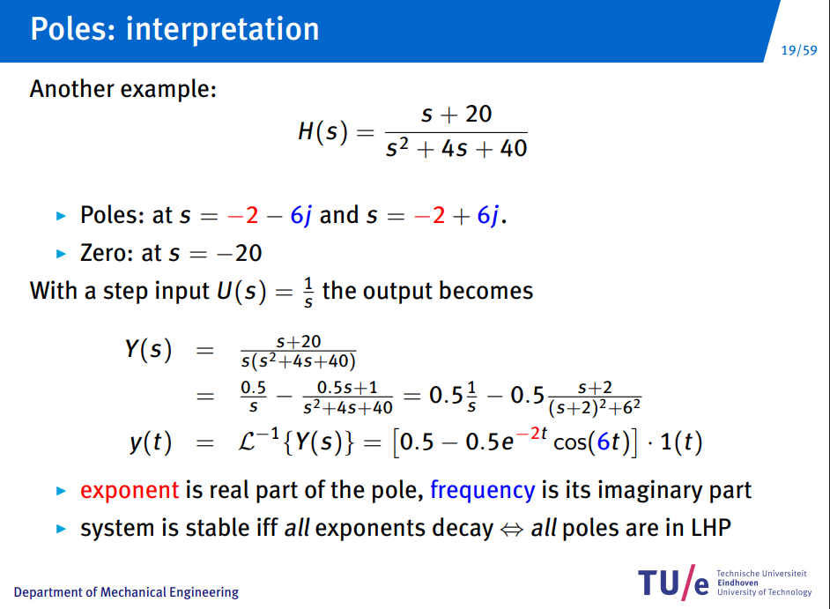

Slide 18
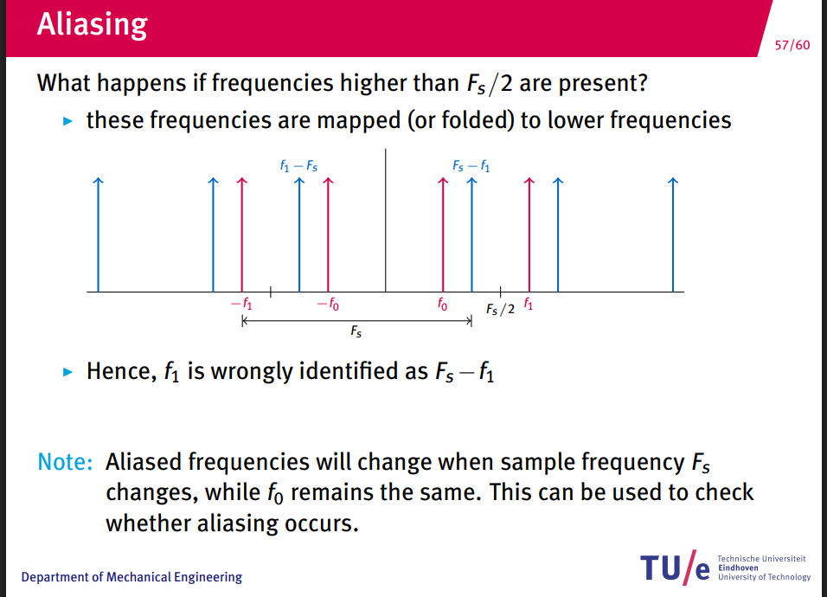

Slide 19
Problem inbetween parametric and nonparametric model closed-loop
FIM parametric. Model incomplete how to deal with augmentation/not modeled
Nonparametric approach
The cleanest defensible split:
- Phase 1 (parametric only): FIM-driven multisine for the 14 physical params — justified by Gevers et al. (2011)
- Phase 2 (augmented model): broadband excitation with uniform spectral coverage over full bandwidth, so the NN has signal everywhere.
This is the standard input design for nonlinear grey-box: Ljung (1999) §13 recommends informative inputs over the full operating range

Slide 20
Question 1
If a question needs to be answered. Make clear here what the problem/question is that needs to be answered. Questions can always be asked outside the meeting, but we may say prepare to explain what you really mean.
Some figure explaining the concept
When applicable, the same as will go in final report. Otherwise just take screenshots from relevant papers.

Slide 21
Previous questions from other slides

Slide 22
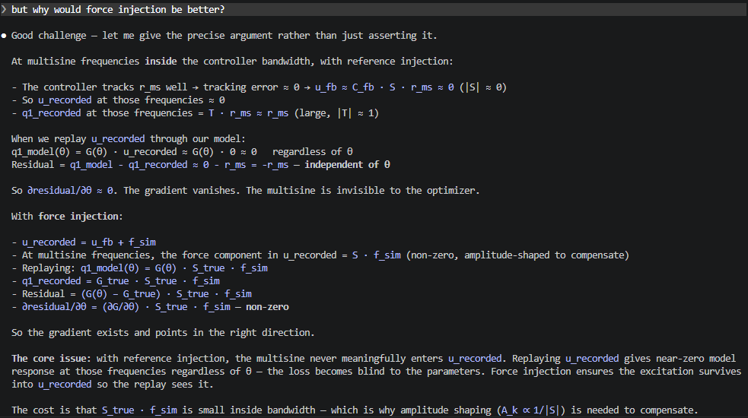
Should I use u_recorded
Helps with determining to use reference or force injection
Is there any benefit between the two

Slide 23
But if we use the data generated with the use of the FIM approach, will this not be uninformative for the unmodeled dynamics? and is a
more general nonparametric approach then not better?
Or could we focus on the coupling somehow?

Slide 24
Outline next week
What is next on the planning and how is that going to be solved
This is also where new action points are formulated. What are you going to do next week.

Slide 25
Possible Gantt-chart or Planning
To keep an overview of what the progress overall is.

Slide 26
Trajectories
8 trajectories
Plus test and validation

Slide 27
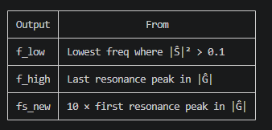
Pre-analysis
diagnostics_system.m gives you a clean, theoretically grounded
argument:
- "We inject at frequencies where |Ŝ|² > 0.1 — below that the
controller suppresses the force before it reaches the plant"
(f_low)
- "We inject up to the last resonance in |Ĝ| — above that the
plant dynamics no longer carry parameter information" (f_high)
- "We sample at 10 × f_high for BPTT" (fs_new, D)

Slide 28
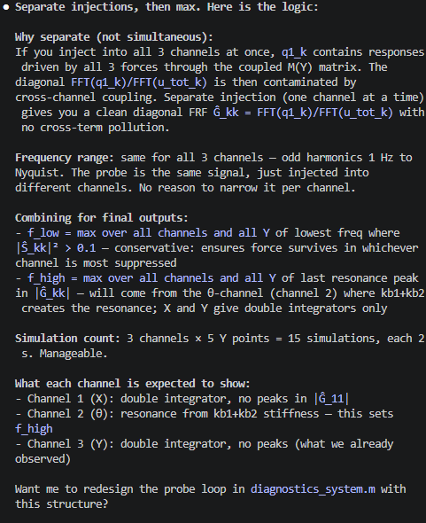

Slide 29
Here is what you need to explain, structured as a supervisor conversation:
---
Why a pre-analysis at all?
The identification multisine requires three design choices: frequency band [f_low, f_high], injection amplitude, and
phase. Without pre-analysis these are found by trial and error (scanning). On hardware you cannot scan — you need
correct parameters before touching the machine. The pre-analysis determines them from a short closed-loop probe
simulation.
---
The probe signal — and yes, Schroeder is here:
The probe is a Schroeder-phase odd-harmonic multisine (Schroeder 1970). Schroeder phases minimize the crest factor —
the ratio of peak to RMS amplitude. With ~10000 harmonics, zero-phase cosines all sum coherently at t=0, producing a
peak force of order sqrt(N_harmonics) × RMS — far above the hardware limit. Schroeder phases spread the peaks so the
crest factor stays close to 1. The FRF ratios Ŝ and Ĝ are phase-invariant — phase cancels in the ratio — so Schroeder
phases do not affect the estimates, only the force peaks.
---
What the probe estimates:
Two nonparametric frequency response functions, derived from signal ratios at the excited frequencies:
- Ŝ_c(jω) = FFT(u_modal) / FFT(f_modal) — feedback algebra: how much of the injected force survives the controller
- Ĝ_c(jω) = FFT(q_modal) / FFT(u_modal) — plant equation: how much the plant position responds per unit of surviving
force
Both are directional FRFs projected onto each mode direction. Not claimed as modal FRFs.
---
f_low — sensitivity survival threshold:
Lowest frequency where |Ŝ|² > 0.1 (-10 dB), worst-case across all modes and Y. Below f_low the controller suppresses
more than 90% of injected force — no point injecting there. Threshold 0.1 is a declared engineering choice.
---
f_high — cumulative energy criterion:
The closed-loop force-to-position response is Q/F_sim = Ĝ × Ŝ (feedback algebra). f_high is the highest frequency
where the tail energy above that frequency still contains more than 5% of the total response energy in the usable
band. Above f_high the plant response is negligible — the injected force produces no measurable output. The 5%
tolerance is a declared engineering choice.
---
A_max — 40% of hardware actuator limit:
Declared engineering choice. Leaves 60% actuator capacity for trajectory tracking and safety margin. Same for all
trajectories — conservative by construction.
---
What this replaces:
The export script scanned candidate bands [5-400 Hz] and amplitudes [10-800 N] on actual trajectory simulations and
picked winners by a scoring formula. The pre-analysis recovers the same result ([43, 195] Hz, ~300 N) directly from
the probe data without any scanning or scoring.

Slide 30
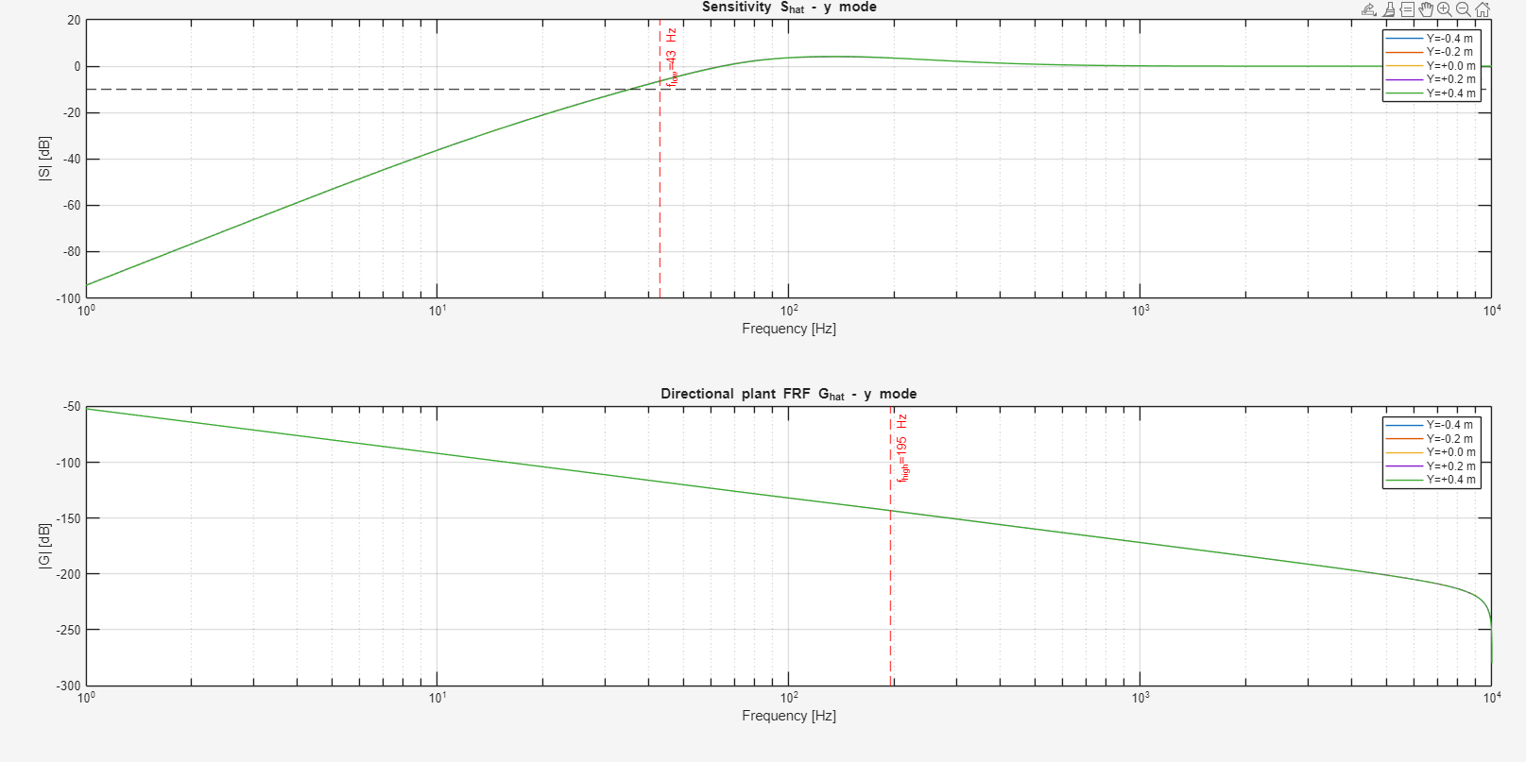

Slide 31
Multisine design

Slide 32
● Let me go through every design element needed for Step 1 and whether it is justified.
---
1. Trajectory reference design
Smooth third-order setpoint profiles (jerk-limited). Already implemented in thirdOrderSetpointETEL. Hardware limits
(position, velocity, acceleration) applied to r_total at design time.
Theory: standard motion control practice, hardware constraints. Clean.
---
2. Leakage-free period alignment
Trajectory length padded to integer multiples of T_p = 1 s so the multisine is periodic within the simulation window.
Theory: P&S Ch.2 §2.2.3 — leakage-free DFT requires integer periods. Already in export script. Clean.
---
3. Odd harmonics only
Theory: P&S Ch.4 §4.3.2 — odd harmonics allow detection of even nonlinearities. PE condition: F ≥ 7 odd bins in
[f_low, f_high]. With [43, 195] Hz and f0=1 Hz there are ~76 odd bins. Clean.
---
4. Schroeder phases
Theory: Schroeder 1970 — minimizes crest factor for a given set of harmonics. Formula: φ_k = -π·k·(k-1)/F. Clean,
citable.
---
5. Different seed per mode
The export script uses a different phase offset per mode to reduce cross-correlation between simultaneously injected
modes. This is practical but:
- It is NOT the rigorous orthogonal MIMO excitation from Pintelon et al. (2011)
- Declared limitation: signals are low-correlation, not strictly orthogonal
- For BPTT identification (not FRF estimation) strict orthogonality is not required
Honest framing: declared engineering choice, not theory-mandated.
---
6. Force injection post-controller
Theory: D-048, feedback algebra — U_total = S × F_sim. Keeps reference clean, excites plant directly. Clean.
---
7. Band [f_low, f_high] and A_max from step0_outputs.mat
Already justified by the pre-analysis. Clean.
---
8. Mode assignments per trajectory
This is the one piece with no theory. Which modes to inject into which trajectories (T4 diff only, T1 y only, etc.) is
driven by which parameters each trajectory is designed to excite. This is experiment design reasoning — physically
motivated but not from a paper.
---
Honest summary:
┌─────────────────────────────────┬───────────┬───────────────────────────────────────┐
│ Element │ Justified │ Source │
├─────────────────────────────────┼───────────┼───────────────────────────────────────┤
│ Schroeder phases │ Yes │ Schroeder 1970 │
├─────────────────────────────────┼───────────┼───────────────────────────────────────┤
│ Odd harmonics │ Yes │ P&S Ch.4 §4.3.2 │
├─────────────────────────────────┼───────────┼───────────────────────────────────────┤
│ Leakage-free periods │ Yes │ P&S Ch.2 §2.2.3 │
├─────────────────────────────────┼───────────┼───────────────────────────────────────┤
│ Band [f_low, f_high] │ Yes │ Pre-analysis (this session) │
├─────────────────────────────────┼───────────┼───────────────────────────────────────┤
│ Amplitude A_max │ Partly │ 40% rule declared │
├─────────────────────────────────┼───────────┼───────────────────────────────────────┤
│ Force injection post-controller │ Yes │ Feedback algebra │
├─────────────────────────────────┼───────────┼───────────────────────────────────────┤
│ Simultaneous multi-mode │ Partly │ Hardware limit check, not MIMO theory │
├─────────────────────────────────┼───────────┼───────────────────────────────────────┤
│ Mode assignments per trajectory │ No theory │ Physics-motivated engineering choice │
└─────────────────────────────────┴───────────┴───────────────────────────────────────┘
Everything is implementable and honestly frameable. The weak points are declared heuristics, not hidden assumptions.
Ready to write the new file?

Slide 33
Segment length
# THEORY: Lecture 3 periodic measurement (5SMB0) — integer periods required
seg_period = ceil(N_PERIODS / f_osc_min × fs_new)
Resampling _diag_fft

Slide 34
Yes, pure heuristic. Breaking it down:
- N_PERIODS / f_osc_min — "observe the slowest mode for N_PERIODS complete
cycles." No primary source derives this as a BPTT segment length criterion. It
is a physically motivated engineering choice.
- N_PERIODS = 3 — completely arbitrary. The theory doc says this explicitly: "No
primary source. 3 × T_p at f_osc_min = 3 × 0.2 s = 0.6 s."
- f_osc_min from FFT — makes it nonparametric, but does not add theoretical
backing to the formula itself.
The formula sounds reasonable but has no derivation. The only BPTT-specific
theory with a derivation in the theory doc is Aicher et al. (2019): bias decays
as β^(K−τ)/(1−β), giving T ≳ 3–5 × τ_max ≈ 4700 samples.
So the honest situation is:
┌────────────────────────────┬────────────────────────┬────────────────────┐
│ Formula │ Source │ Gives │
├────────────────────────────┼────────────────────────┼────────────────────┤
│ N_PERIODS / f_osc_min × │ HEURISTIC — no primary │ ~600 samples, fast │
│ fs_new │ source │ training │
├────────────────────────────┼────────────────────────┼────────────────────┤
│ 3–5 × τ_max × fs_new │ THEORY — Theorem 1 │ ~5000 samples, │
│ (Aicher et al. 2019) │ with derivation │ slow training │
└────────────────────────────┴────────────────────────┴────────────────────┘
You are choosing the heuristic for speed, with empirical evidence (4000 samples
recovers parameters) that the system is identifiable, and you declare the 600 as
a computational trade-off. That is a defensible position for a supervisor
conversation — as long as it is labeled HEURISTIC and not presented as theory.

Slide 36
Is this actually verified to be in the lecture?: # THEORY: Lecture 3 periodic
measurement (5SMB0) — integer periods required
seg_period = ceil(N_PERIODS / f_osc_min × fs_new)
● No, it is not verified. Applying the CLAUDE.md rule: "Literature validates only
if the formula, variable, and context match — not just the numeric constant."
Lecture 3 (5SMB0) "integer periods required" refers to: the measurement window
must be an integer multiple of the excitation period T_p to avoid spectral
leakage in the FFT. That is a statement about T_p = 1/f0 (the multisine period),
not about f_osc_min.
The formula ceil(N_PERIODS / f_osc_min × fs_new) is about covering N_PERIODS
full oscillations of the slowest natural frequency of the plant. That is a
different concept — it is not stated in Lecture 3. The variable is different
(f_osc_min vs f0), the motivation is different (observing system dynamics vs
leakage-free FFT).
So the label is wrong. The formula is either:
- HEURISTIC — "observe the slowest mode for 3 full cycles" is a reasonable
engineering rule but has no direct literature source in this exact form for BPTT
- Or needs a different, correct source if one exists
The honest label would be:
# HEURISTIC: segment spans N_PERIODS cycles of the slowest plant mode —
# ensures BPTT gradient sees complete oscillations of torsional parameters.
# N_PERIODS=3 is an engineering choice with no direct BPTT literature source.
seg_period = ceil(N_PERIODS / f_osc_min × fs_new)
Does the supervisor point to a specific paper or lecture for the FFT-based
segment criterion?

Slide 37
Pre-analysis
f_low — loop over all 3 modes × 5 Y points, run closed-loop simulation with
broadband Schroeder multisine probe, compute Ŝ = FFT(u_total) / FFT(f_sim). Find the
first frequency where |Ŝ|² > 0.1. Worst-case across all modes and Y points.
f_high — from the same simulations, compute |Ĝ × Ŝ|² = |Q/F_sim|² (closed-loop
force-to-position). Build the cumulative tail energy from high to low frequency.
Find the last frequency where the tail still contains ≥ 5% of total energy.
Worst-case across all modes and Y points.
A_max — no simulation needed. Just 0.4 × [min(F_X1, F_X2), min(F_X1, F_X2), F_Y]
where the hardware RMS limits are [916, 916, 656] N. Gives [366, 366, 262] N RMS per
mode.

Slide 40
Trajectories
Modes
T1-T8
Val and test

Slide 41
Closed-loop
MIMO
LPV
System identification
Before or after controller multisine injection
Controller… ruleofthumb currently

Slide 42
Multisine after controller
Post-controller multisine injection is preferred when the identification data should represent plant force input to motion output, because the total applied force can be logged and used directly as model input. The drawback is that the feedback controller attenuates the resulting motion through the disturbance sensitivity path, so low-frequency excitation inside the feedback bandwidth may be weak. Reference injection gives stronger low-frequency output excitation but identifies the closed-loop reference-to-output path unless the controller force is explicitly reconstructed and used.

Slide 43
Settle time
Tsettle = max(Tsettle_q, Tsettle_u_total)

Slide 44
LTI MIMO closed-loop system.

Slide 45
Show output without multisine
Have to look at the jsum why not identifiable

Slide 46
Originele multisine bepalen..
Segment length 650 werkte wel zonder multisine maar niet met…
Probleem ligt aan…

Slide 47
Step response
Too many issues because…

Slide 48
FRF
Design choices

Slide 49
questions

Slide 50
Should I use u_recorded
Helps with determining to use reference or force injection
Is there any benefit between the two

